Slide 1
Hướng dẫn tổng quan thiết bị Cisco Vyatta HP VSR Juniper
Ths Nguyễn Quốc Sử

Slide 2
Cisco Network Device
Ths. Nguyễn Quốc Sử

Slide 3
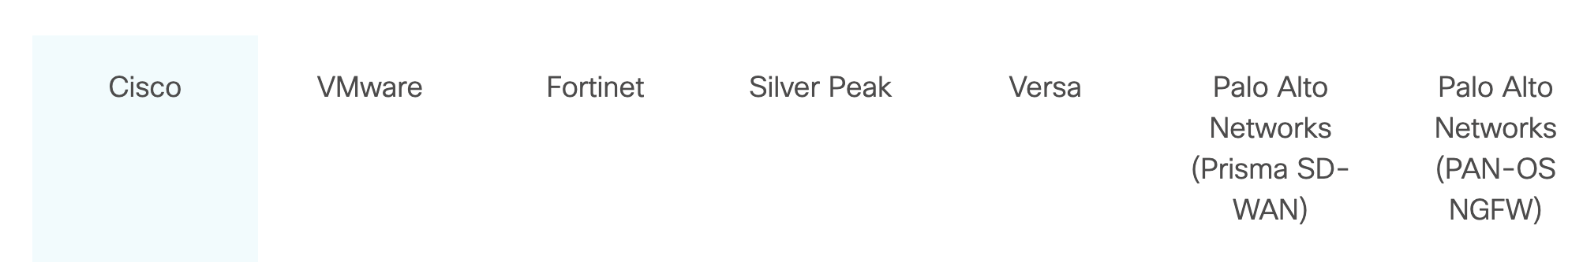
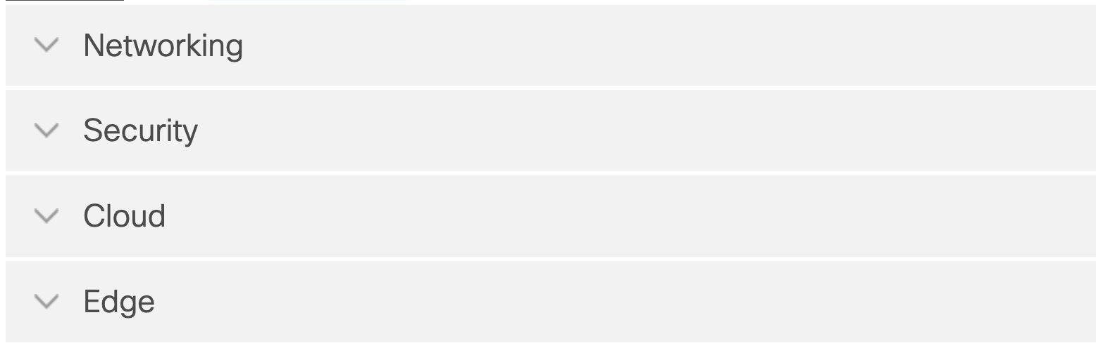

Slide 4
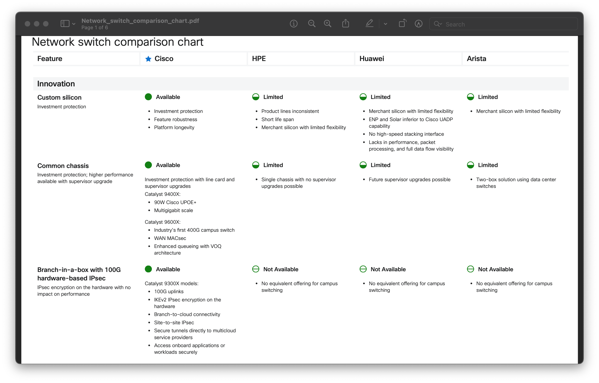
Cisco network switches

Slide 5
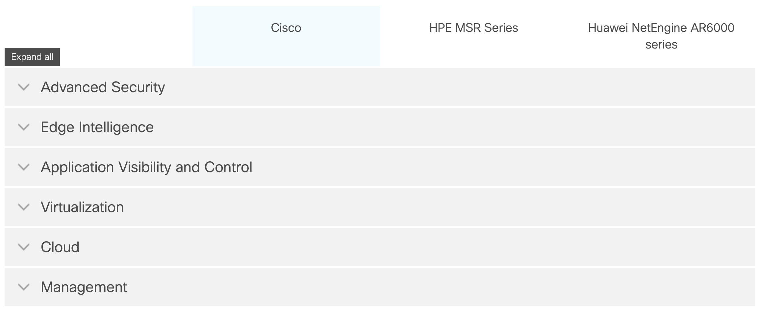
Cisco routers and SD-WAN

Slide 6
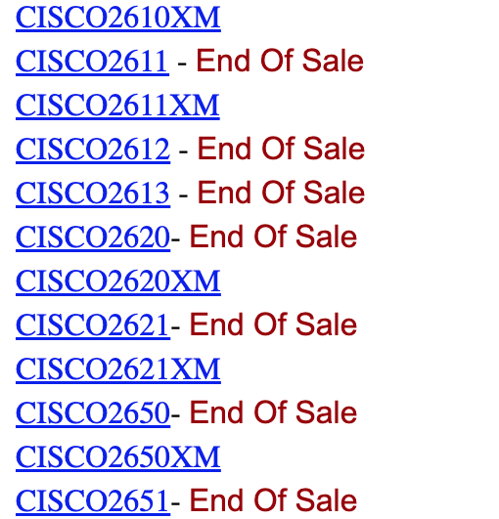
2600 Series
The Cisco 2600/2600XM series family of modular multiservice access routers provides flexible LAN and WAN configurations, multiple security options, voice/data integration, and a range of high performance processors. This range of features make the Cisco 2600/2600XM family the ideal branch-office router for today's and tomorrow's customer requirements.
The latest additions to the Cisco 2600/2600XM series family of Modular Routers include the Cisco 2600XM models and the Cisco 2691. These new models deliver extended performance, higher density, enhanced security performance and increased concurrent application support to meet the growing demands of branch offices.

Slide 7
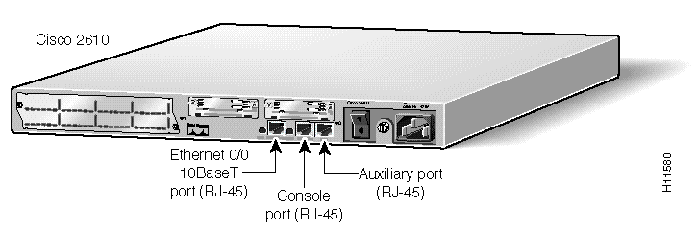
Cisco 2610
One ethernet port, 10 Base-T only, no AUI, One Network Module slot, Two WIC slots.Console and aux ports with max speed of 115.2 KBPS.

Slide 8
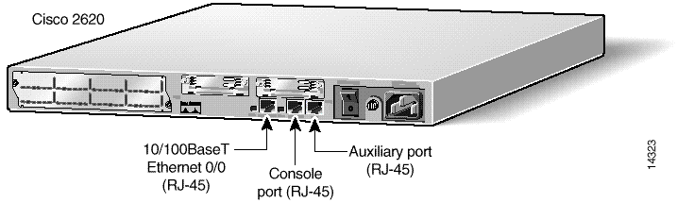
CISCO2620 – 2620XM
One fast ethernet port, 10 Base-T or 100 Base-TX only, no AUI, no MII. One Network Module slot, Two WIC slots. Console and aux ports with max speed of 115.2 KBPS.

Slide 9
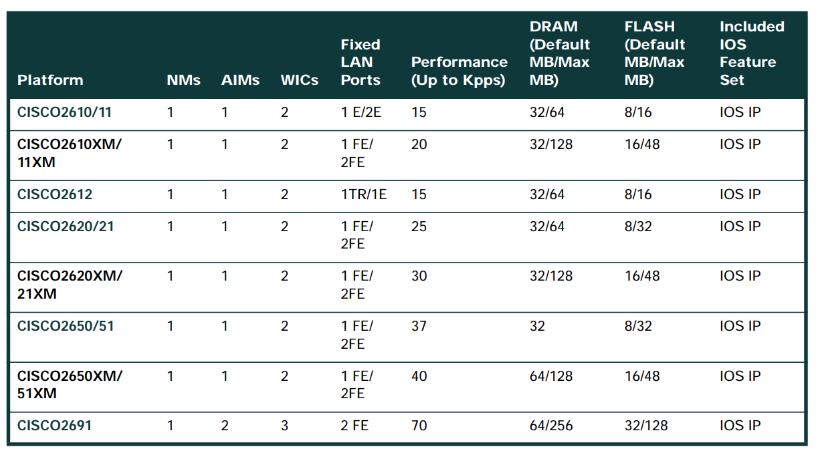
C2600
https://www.cisco.com/web/ANZ/cpp/refguide/hview/router/2600.html

Slide 10
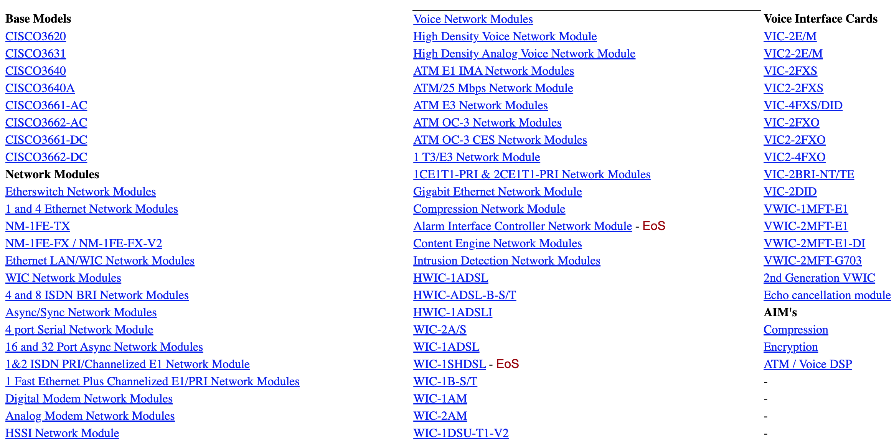
Cisco C3600 Series
https://www.cisco.com/web/ANZ/cpp/refguide/hview/router/3600.html

Slide 11
Cisco 3600 Series
The Cisco 3600 Series is a family of modular, high-performance multiservice access routers for medium and large-sized branch offices and Internet service providers. With over 100 modular interface options (shares modular interfaces with the 2600/2600XM series), the Cisco 3600 Series provides solutions for voice/data integration, virtual private networks (VPNs), dial access, and multiprotocol data routing. Using Cisco's digital and analog voice/fax network modules, the Cisco 3600 Series allows customers to consolidate voice, fax, and data traffic on a single network. Its architecture protects customers' investment in network technology and integrates the functions of several devices into a single, manageable solution. Cisco 3600 VPN and Dial Bundles are also available to also address specific VPN/security, and dial-up remote access server requirements. Customers are encouraged to migrate to the Cisco 3700 Series.

Slide 12
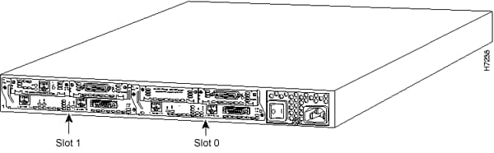
CISCO3620
Two Network Module slots.Console and aux ports with max speed of 115.2 KBPS.

Slide 13
Cisco 7200 Series Routers
Cisco 7200 VXR Series Router
With processing speeds up to 2 million packets per second, port- and service adapters ranging from NxDS0 to Gigabit Ethernet, and OC-3 as well as an unparalleled number of high-touch IP services, the Cisco 7200 VXR series is the ideal Services Aggregation WAN/MAN edge device for enterprises and service providers deploying any of the following solutions:
• WAN edge-Award-winning quality-of-service (QoS) feature performance
• Broadband aggregation-Up to 16,000 Point-to-Point Protocol (PPP) sessions per chassis
• Multiprotocol Label Switching provider edge (MPLS PE)-Number one choice for provider edge deployment today
• Voice/video/data integration-Time-division multiplexer (TDM)-enabled VXR chassis and voice port adapters
• IP-to-IP Gateway Support-Direct IP-interconnections
• IP Security virtual private networking (IPSec VPN)-Scalable to 5,000 tunnels per chassis
• High-End Customer Premises Equipment (CPE)-For managed WAN services saving equipment, transport and administrative cost

Slide 14
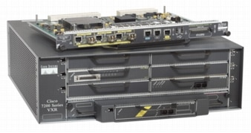
Cisco 7200 Series Routers
Features | Benefits
Up to 2 Mpps Processing Capability | Provides high-performance routing and processing performance
Maximum Connectivity Options | Meets a variety of topology requirements with the widest range of port densities and interface options
Breadth of Services | Supports QoS, security, MPLS, broadband, multiservice, voice, IP-to-IP Gateway and management features for next-generation networks
Investment Protection | Low initial investment with upgrade and redeployment capability
https://www.cisco.com/c/en/us/products/collateral/routers/7200-series-routers/product_data_sheet09186a008008872b.html

Slide 15
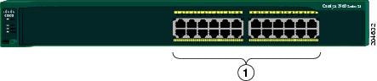
Catalyst 2960-24-S
The 10/100 ports on the Catalyst 2960-Plus 24TC-S, 2960-24TC-S, 2960-Plus 48TC-S, and 2960-48TC-S switches are numbered in the same way as the Catalyst 2960-24-S switch. These switches have dual-purpose ports, that is, 10/100/1000 ports 1 and 2 can use either the SFP module or the RJ-45 connector for that port, but not both at the same time. Use the software to set the connector type for these ports

Slide 16
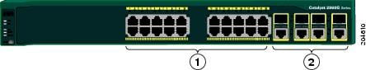
Catalyst 2960G-24TC-L and Catalyst 2960G-48TC-L Switches
0/100/1000 ports | 2 | Dual-purpose ports
https://www.cisco.com/c/en/us/td/docs/switches/lan/catalyst2960/hardware/installation/guide/2960_hg/higover.html

Slide 17
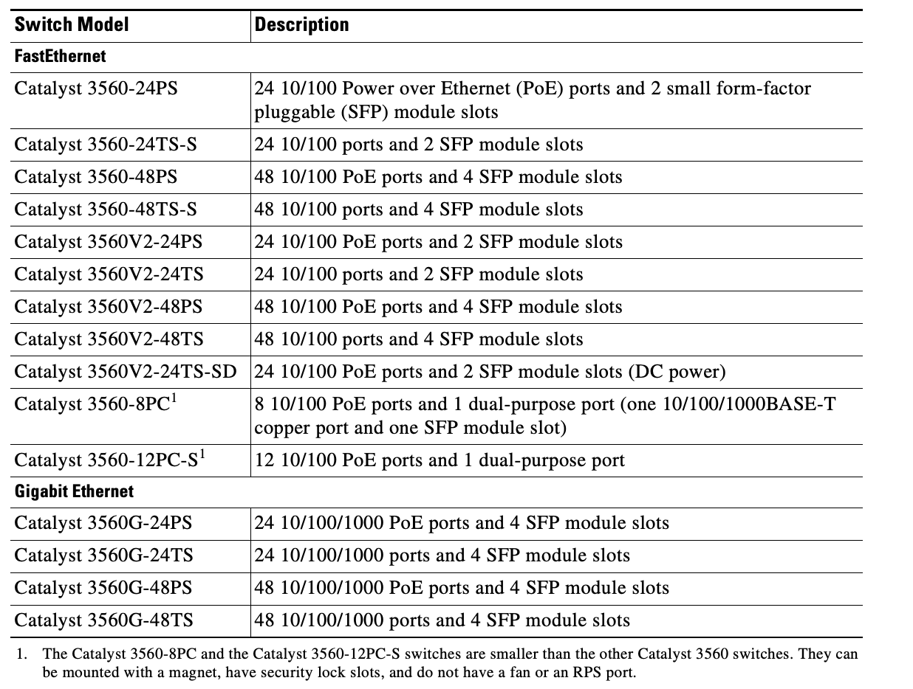
Catalyst 3560 Switch

Slide 18
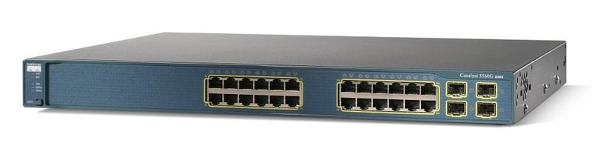
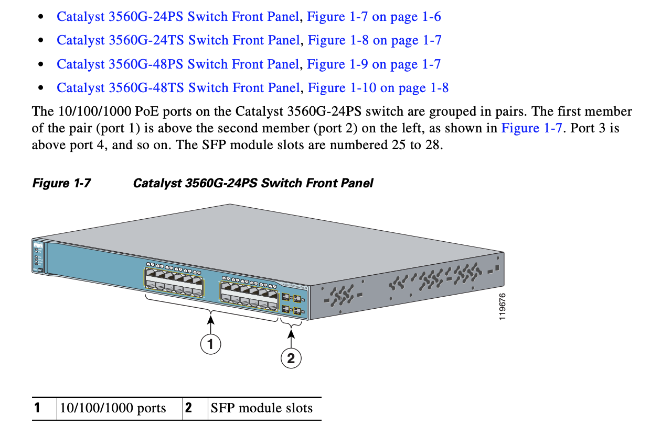
3560-G Gigabit Ethernet Switch

Slide 19
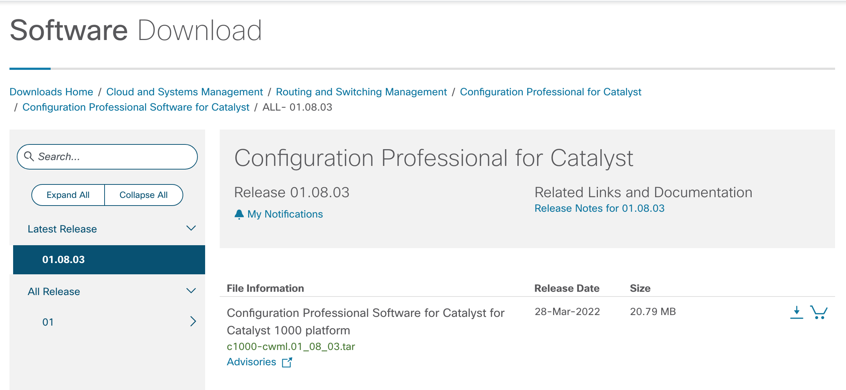
Install Cisco Configuration Professional
Now you can manage all your Cisco Catalyst IOS switches using a web-based user interface. The Configuration Professional gives you a single solution for monitoring and optimizing your devices, plus contextual support. Automate your operations and easily troubleshoot your switching networks
https://software.cisco.com/download/home/286310742/type/286310882/os/ALL/release/01.08.03

Slide 21

HPE

Slide 22
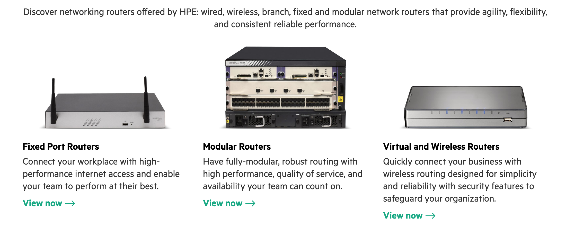
HPE

Slide 23
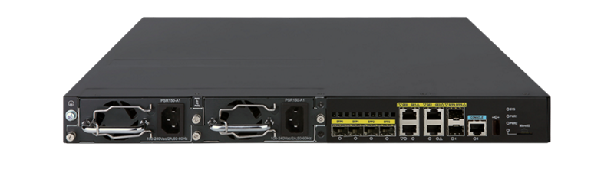
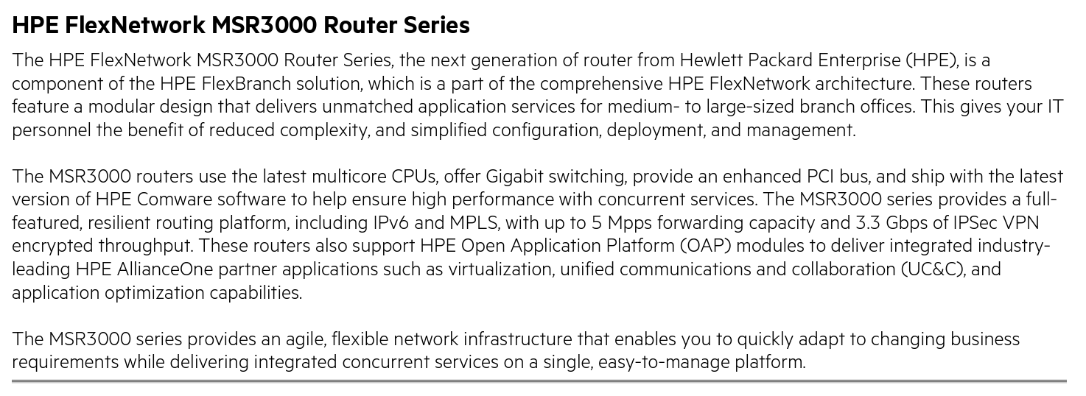
HPE FlexNetwork MSR3000 Router Series

Slide 24
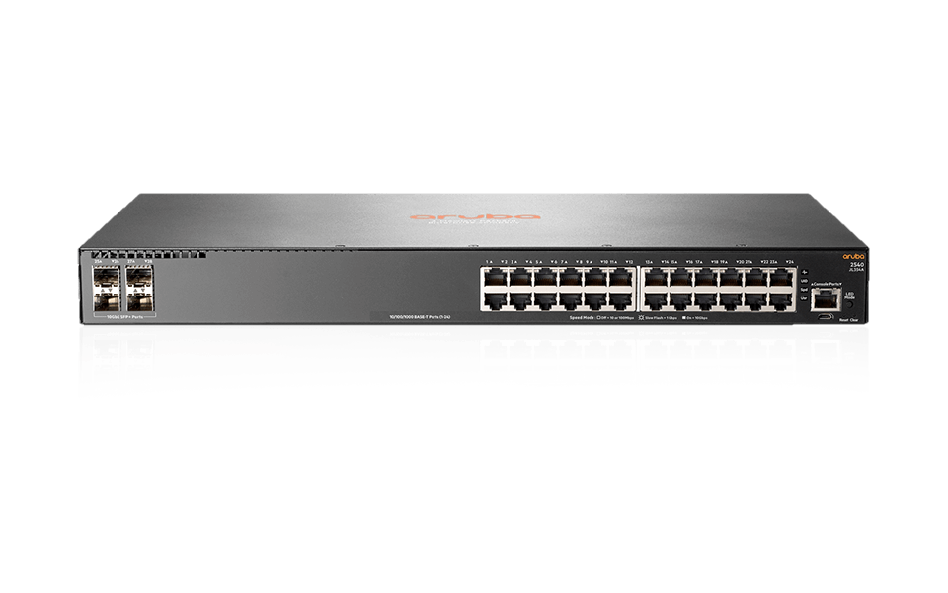
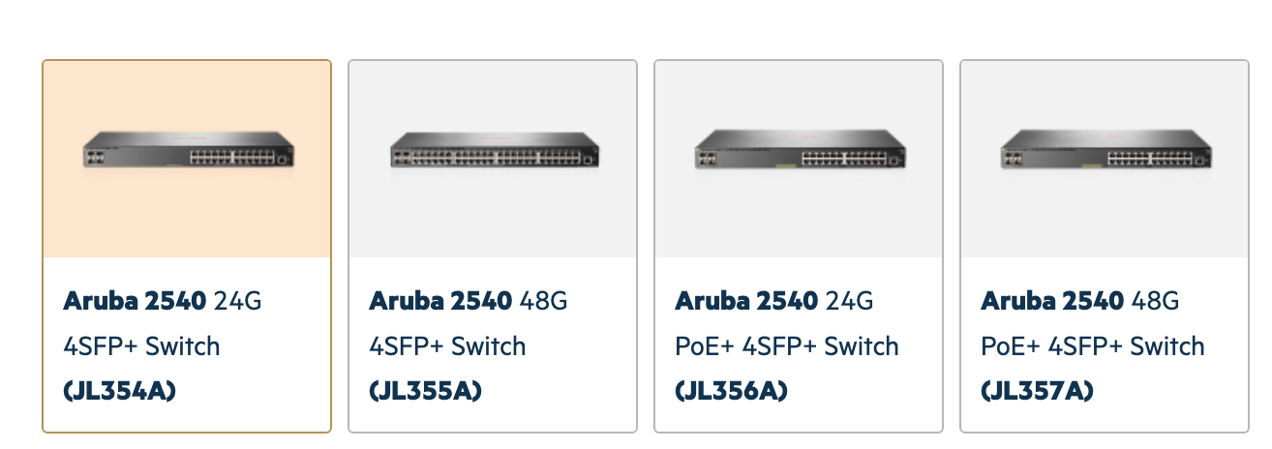
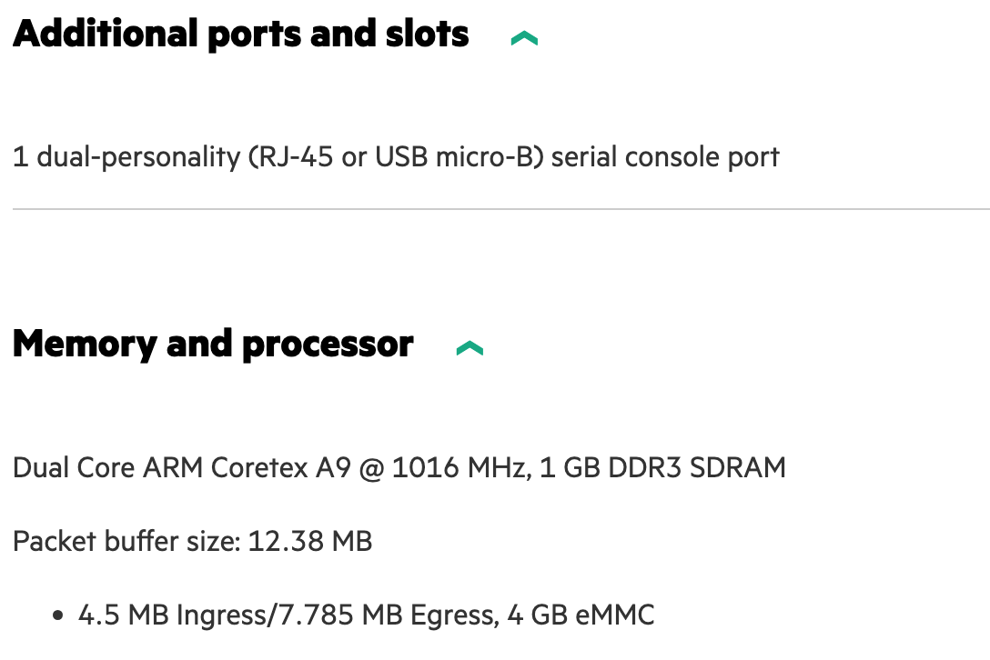

Aruba 2540 Switch Series

Slide 25
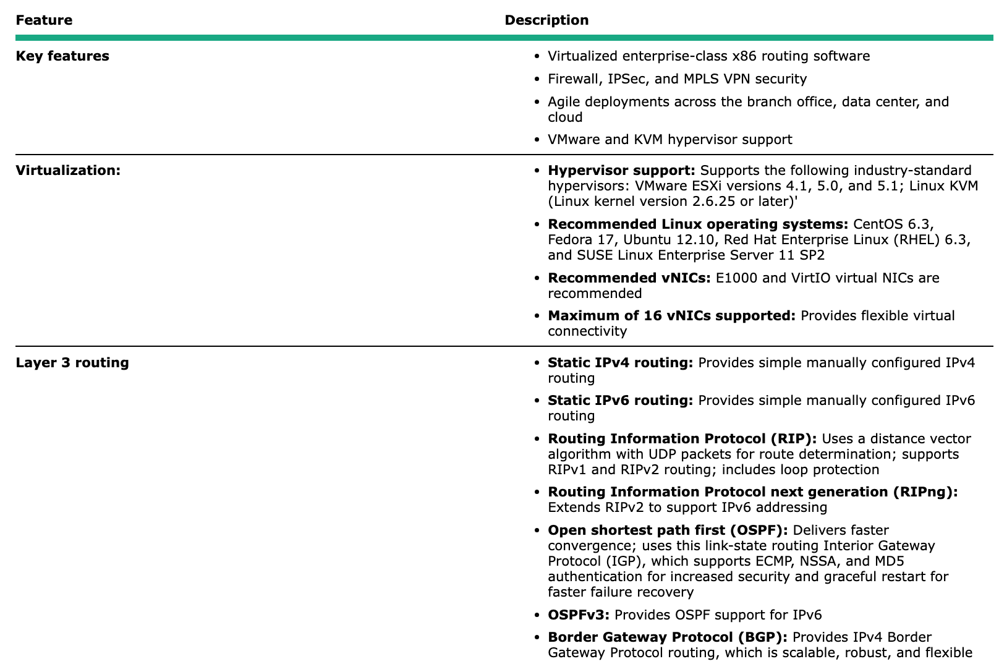
HPE VSR1000 Virtual Services Router
The HPE VSR1000 Virtual Services Router consists of virtualized applications that provide functionality that is similar to physical routers. The VSR1000 series enables significant operational savings as a result of its agility and ease of deployment. Like other virtual applications, the routers run in a virtual machine on an industry-standard x86-based server. Resources on the VSR1000 series can be dynamically allocated and upgraded on demand as performance requirements grow. The VSR1000 series is available in 1, 4, and 8 virtual CPU versions that have no expiration date. Robust routing is provided between networked devices using a number of popular routing protocols.

Slide 26
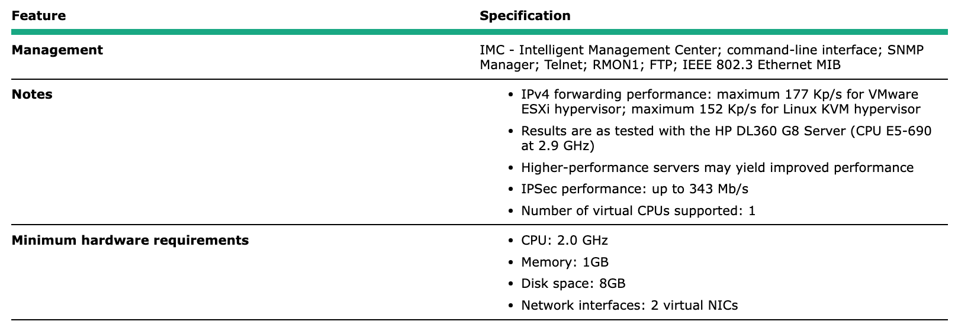
HP VSR1001 Comware 7 Virtual Services Router E-LTU

Slide 27
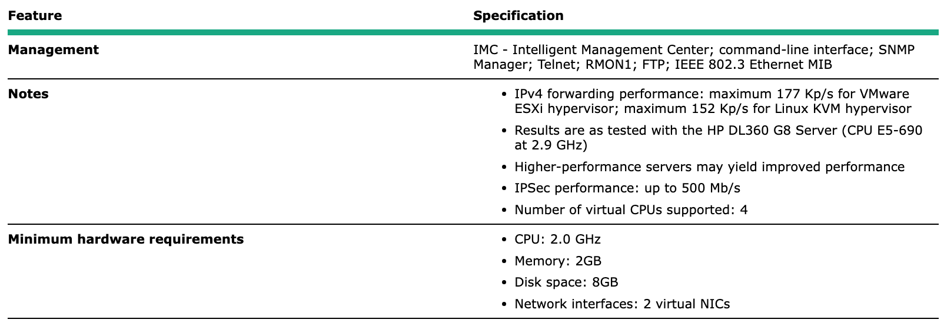
HP VSR1004 Comware 7

Slide 28
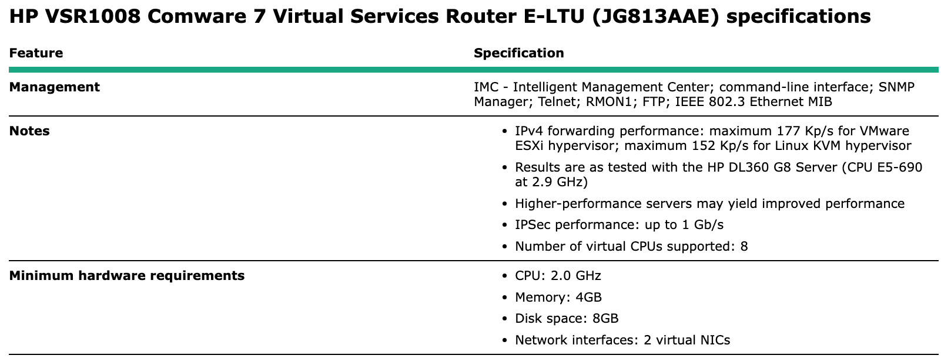
HP VSR1008 Comware 7

Slide 30
Vyatta NOS

Slide 31
Vyatta NOS
Vyatta NOS is a telco grade network services architecture. It provides an easy-to-use, high-performance and scalable platform that can fit a wide range of use cases.
At the fundamental level, Vyatta NOS is a modified Linux network operating system. It is flexible and extensible so that you can configure it to provide a wide range of network functions.
For example:
router — with support for most standard routing protocols
switch — with support for both software- and hardware-based L2 switching
VPN gateway/concentrator — with support for IPsec VPNs
NAT gateway — with support for SNAT/DNAT/firewall
CGNAT server/gateway
https://docs.vyatta.com/en

Slide 32
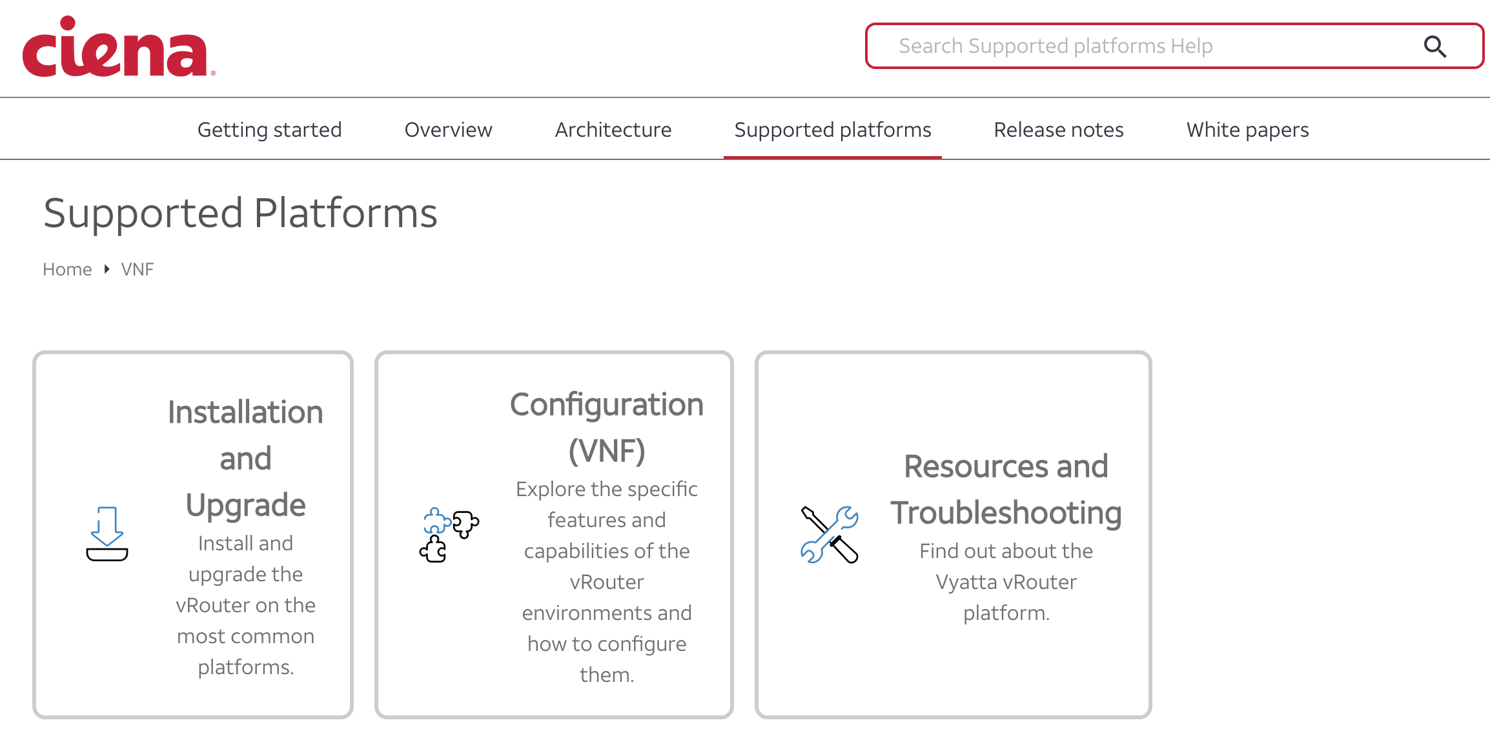
Vyatta NOS
https://docs.vyatta.com/en/supported-platforms/vnf

Slide 33
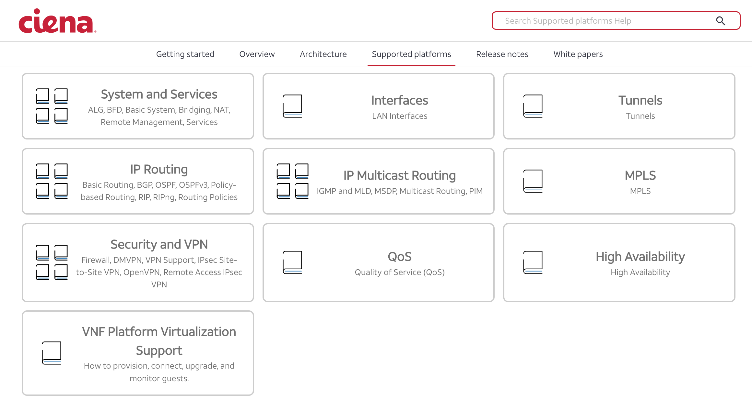
Vyatta NOS
https://docs.vyatta.com/en/supported-platforms/vnf/configuration-vnf

Slide 34
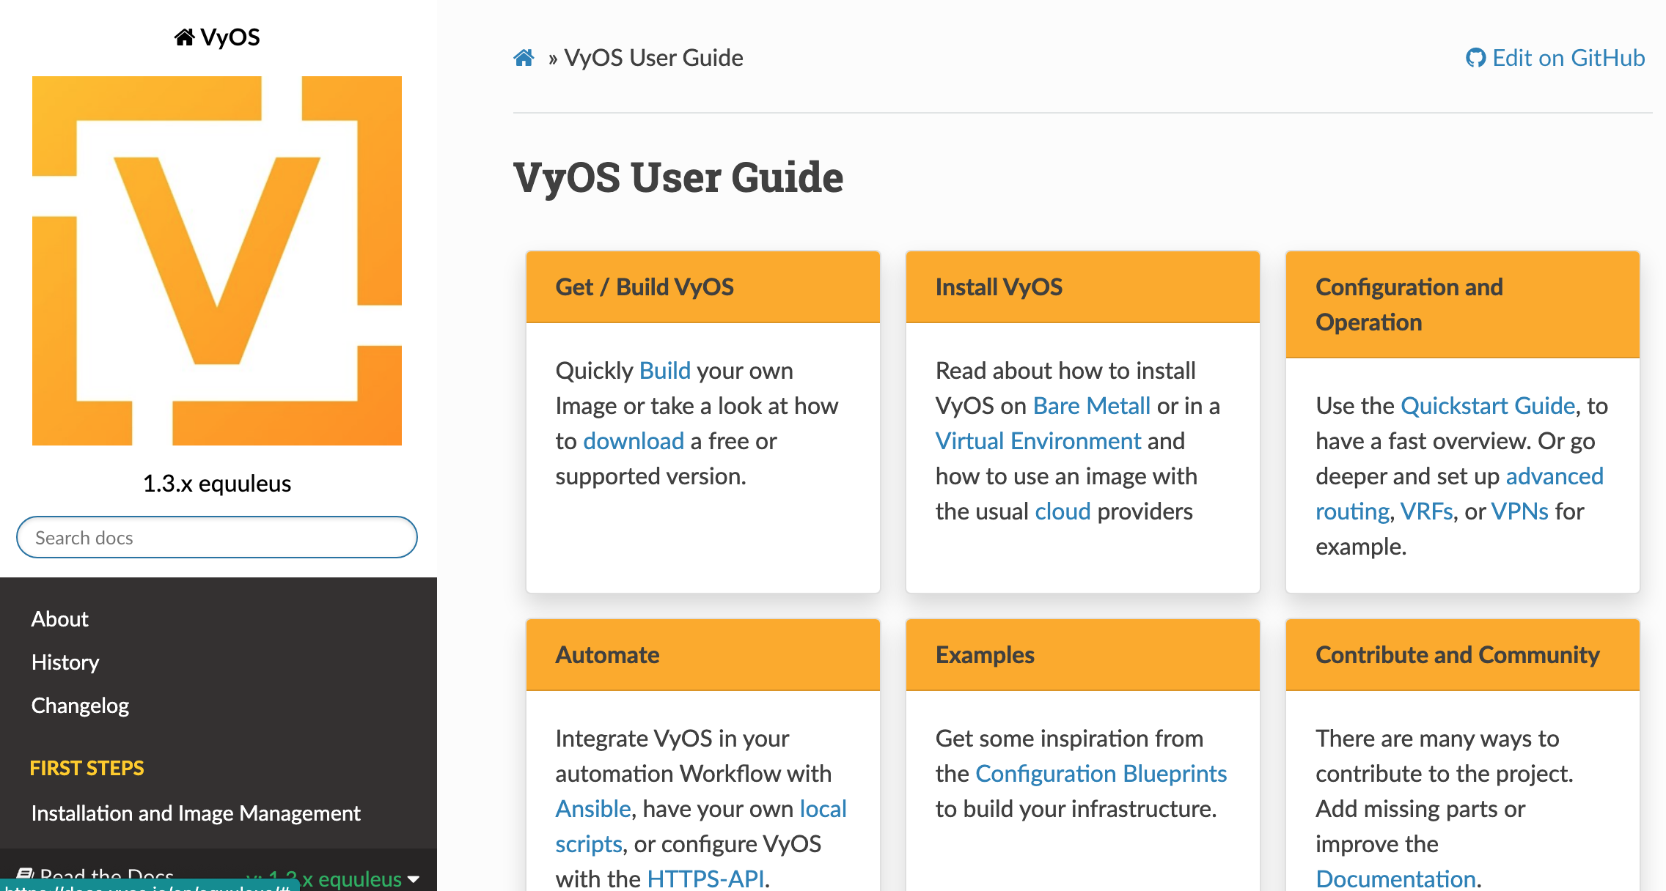
VyOS
https://docs.vyos.io/en/equuleus/

Slide 35
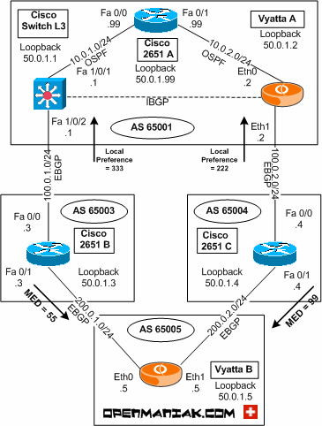
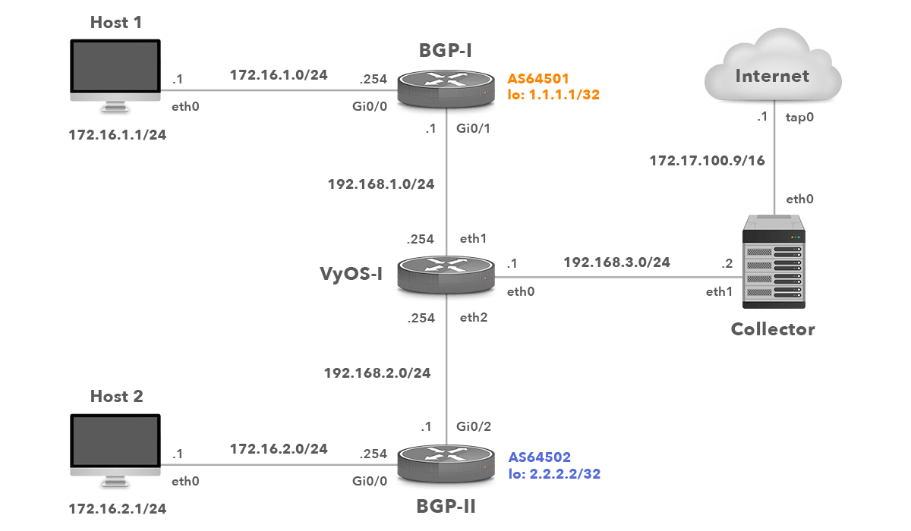
Logical VyOS

Slide 36
Juniper

Slide 37
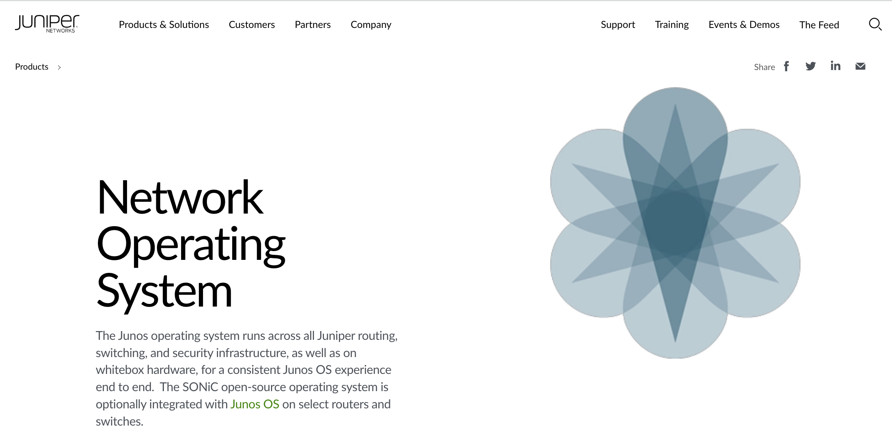
Juniper - Junos

Slide 38
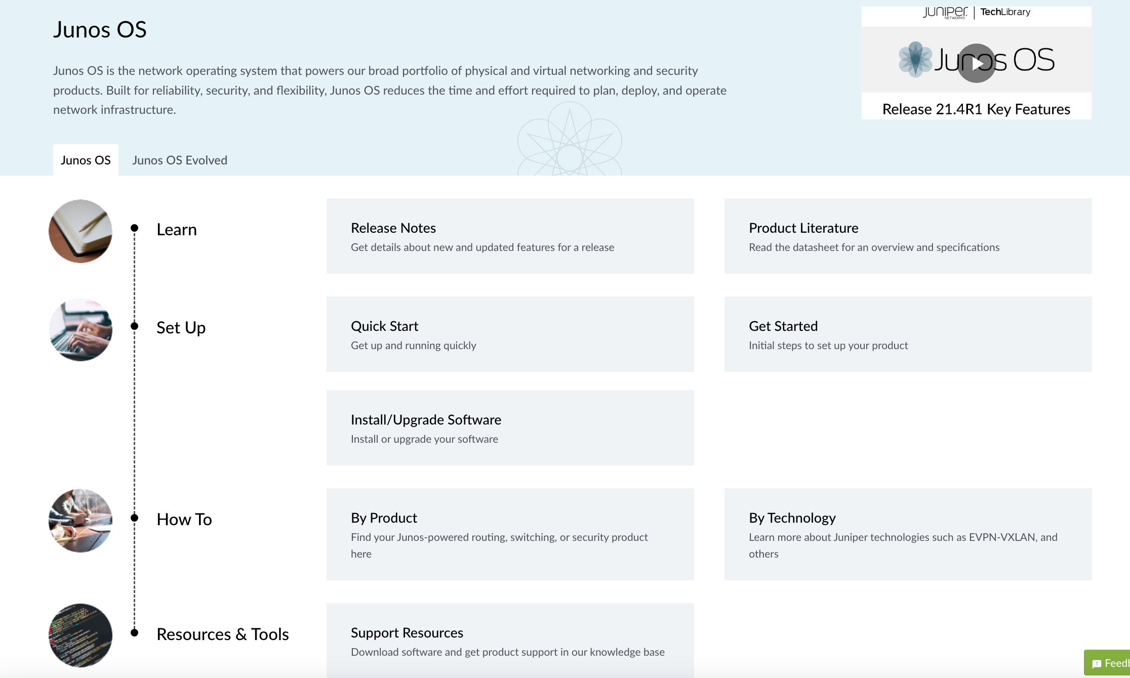

Slide 39
Juniper Open Learning: Your Path To Juniper Certification

Slide 40
Juniper Virtual Route Reflector
The virtual Route Reflector (vRR) feature allows you to implement route reflector capability using a general purpose virtual machine that can be run on a 64-bit Intel-based blade server or appliance. Because a route reflector works in the control plane, it can run in a virtualized environment. A virtual route reflector on an Intel-based blade server or appliance works the same as a route reflector on a router, providing a scalable alternative to full mesh internal BGP peering. The vRR feature has the following benefits:
Scalability: By implementing the vRR feature, you gain scalability improvements, depending on the server core hardware on which the feature runs. Also, you can implement virtual route reflectors at multiple locations in the network, which helps scale the BGP network with lower cost.
Faster and more flexible deployment: You install the vRR feature on an Intel server, using open source tools, which reduces your router maintenance.
Space savings: Hardware-based route reflectors require central office space. You can deploy the vRR feature on any server that is available in the server infrastructure or in the data centers, which saves space.

Slide 41

Virtual Route Reflector Package Contents
The vRR software packages are available as these types of packages:
Application package—This package is for launching vRR software in a virtualized environment for the first time.
Install package—This package is for upgrading vRR software that is already running to the next Junos OS release.
Starting with Junos OS Release 15.1, the install package for vRR (jinstall64-vrr-*.*) is no longer available. Use the install package of Junos OS for MX Series platforms: junos-install-mx-x86-64-*.tgz (e.g. use 64 Bit-MX High-End Series for MX240: Downloads for MX240) to upgrade vRR
https://www.juniper.net/documentation/us/en/software/vrr/vrr-vmware/vrr-kvm/topics/concept/virtual-route-reflector-understanding.html

Slide 42
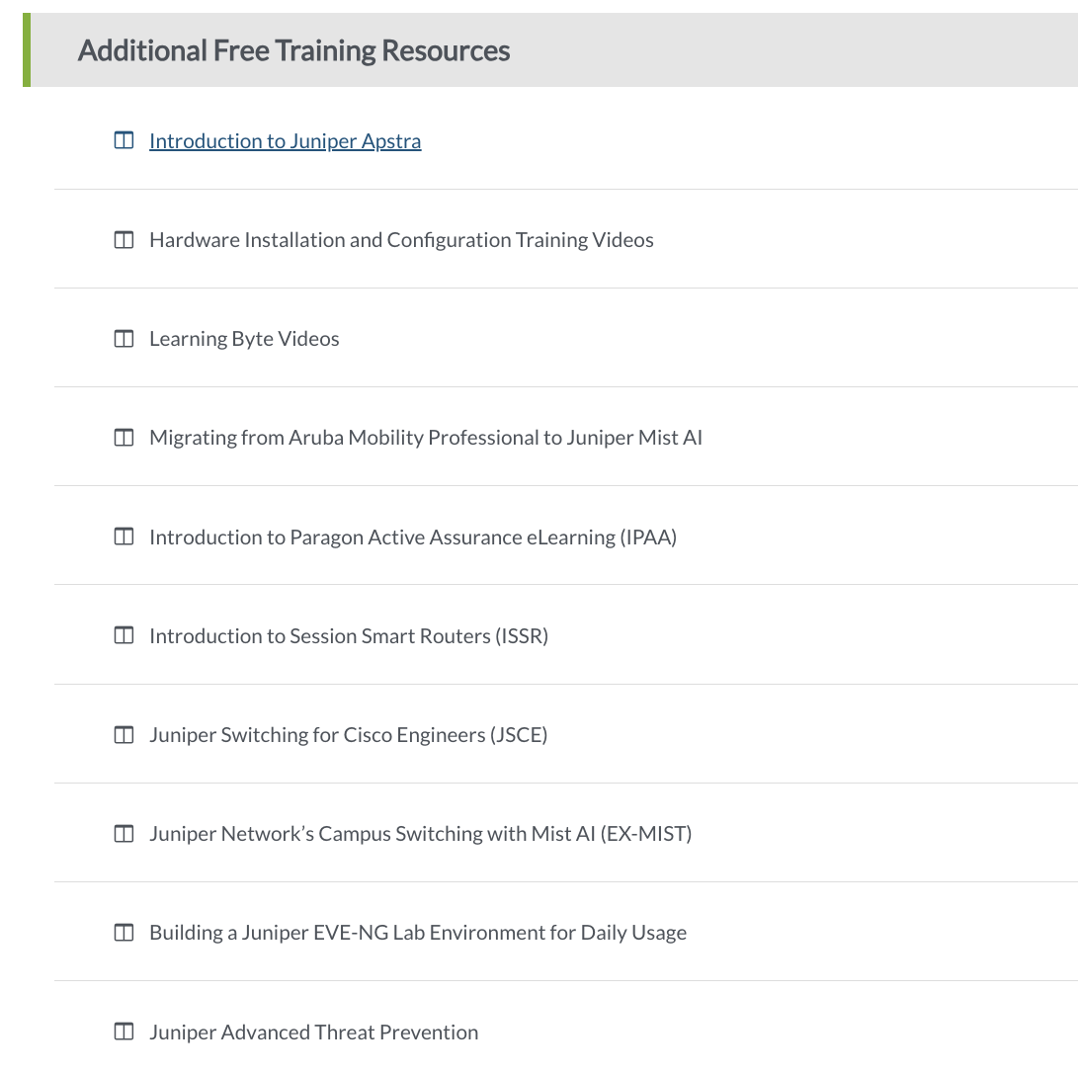
https://learningportal.juniper.net/juniper/user_activity_info.aspx?id=700&TrackId=JNPR-junos
https://learningportal.juniper.net/juniper/user_activity_info.aspx?id=JUNIPER-OPEN-LEARNING&TrackId=jnet-nav#static

Slide 43
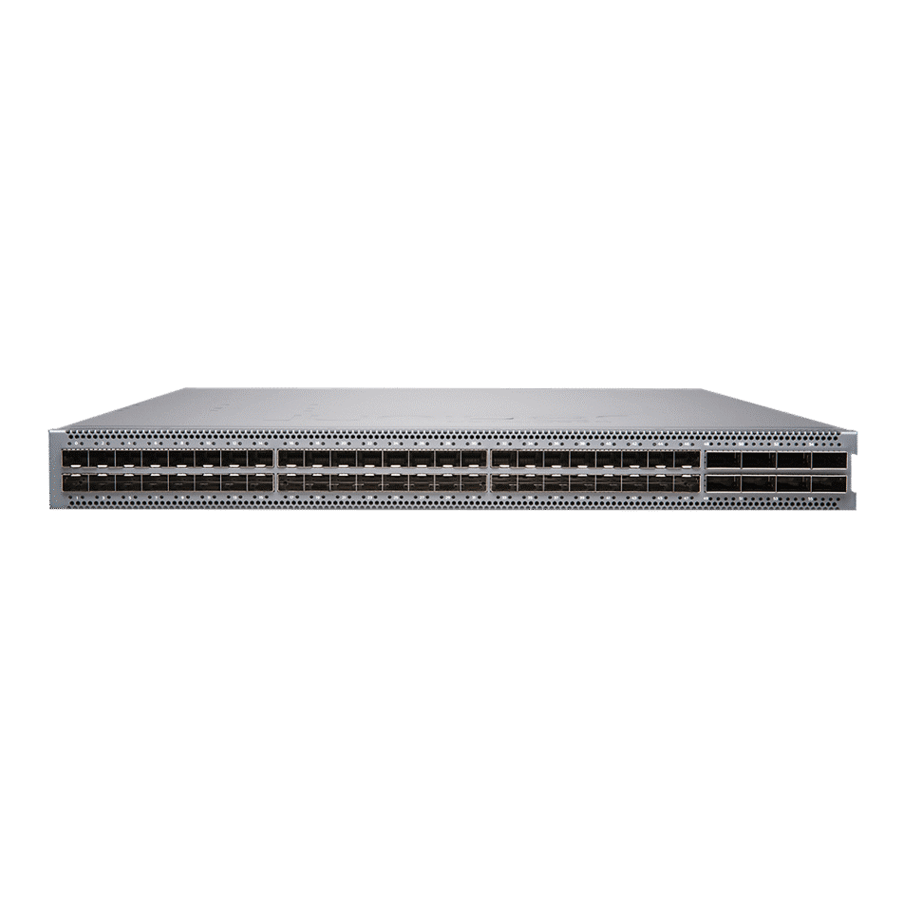
QFX5120 Switches
The QFX5120 line offers 1/10/25/40/100GbE Ethernet switches, including models with 1/10GbE copper interfaces, for data center, data center edge and interconnect, and campus deployments. QFX5120 switches are packed with software features that support modern IP fabric architectures with EVPN-VXLAN.

Slide 44

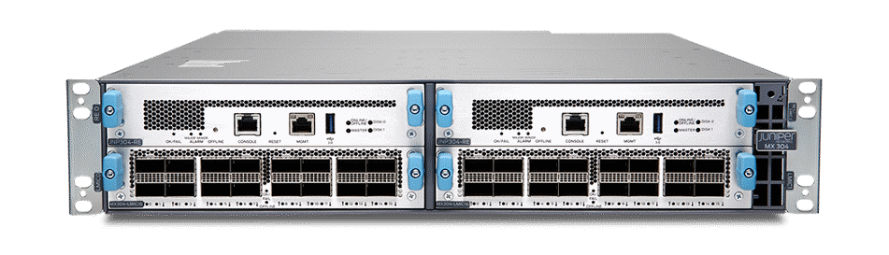
MX304 Universal Routing Platform
The MX304 Universal Routing Platform delivers massive scale and efficiency for space- and power-constrained environments. This carrier-grade, multiservice platform with extensive automation capabilities enables operators to meet constantly expanding bandwidth, subscriber, and service demands. The form factor and features make the MX304 an ideal fit in the business edge and metro Ethernet environments, as well as data center and colocation facilities.
Powered by Trio 6 silicon, the MX304 scales to 4.8 Tbps of throughput in just 2 RU, delivering unmatched edge router density and performance while consuming just 0.3 Watts/Gb of throughput. In addition, because it’s built on the Junos OS, the MX304 delivers nearly endless data-plane programmability, giving you the freedom to implement new network innovations.

